Slide 1
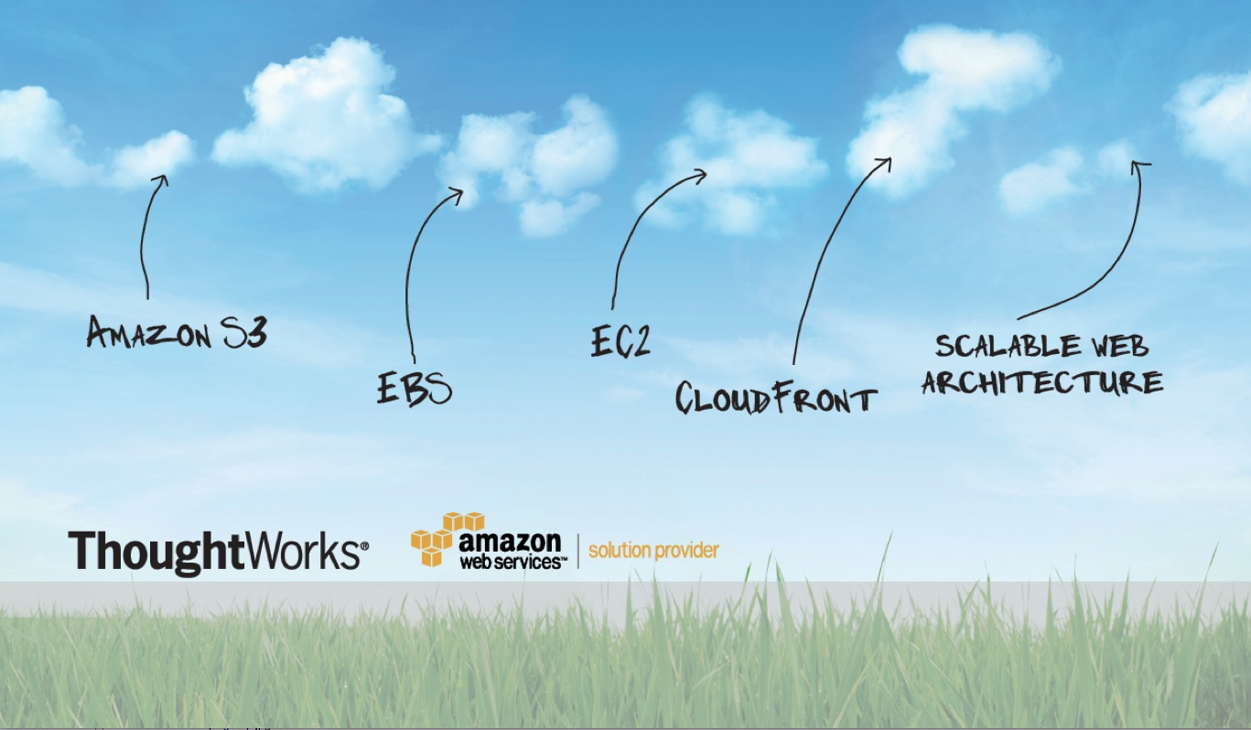
Welcome
Notes:
Windows check – big chunk of deck – lots of problems with locked down access, etc., etc.
John – sysadmin
Tran – QA
Martin Andrew – sysadmin
Likun – dev
Chetan – VMWare setting up VMWare side of cloud stuff for REA
Ash – SiteOps manager
Breezy – dev
Jeff - dev

Slide 2

Notes:
1700 spread across 20 offices in 8 countries: Australia, Brazil, Canada, China, Germany, India, the United Kingdom, United States, Singapore, and most recently South Africa.

Slide 3



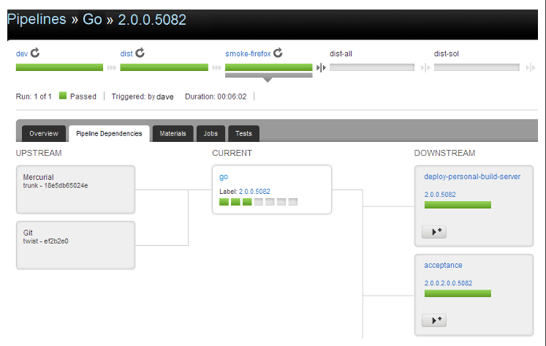
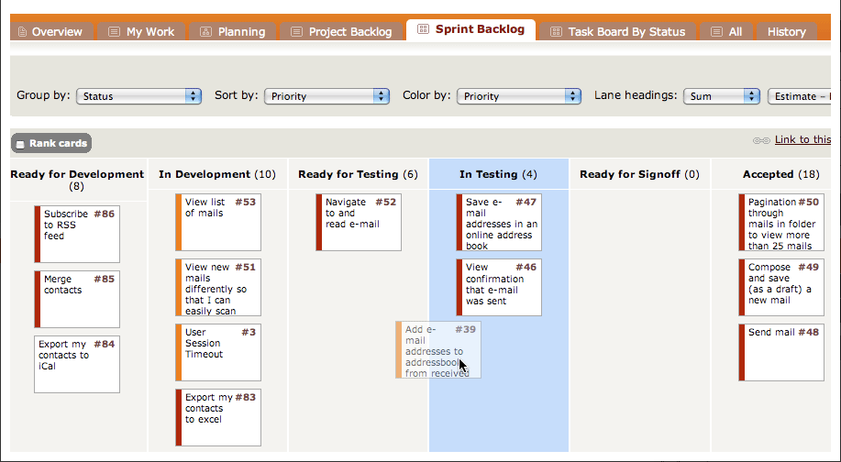

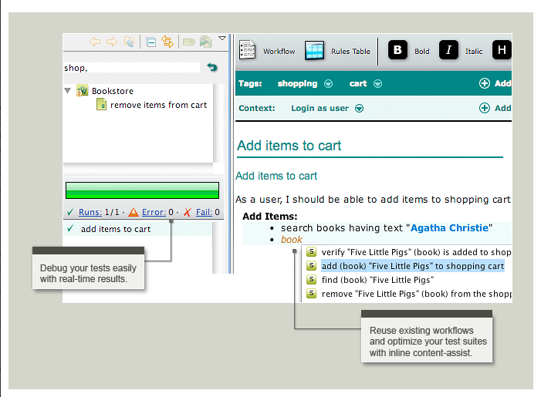
Notes:
Mingle, Twist, Go, formerly known as Cruise

Slide 4

+
Notes:
Talk about partnership with Amazon & ThoughtWorks in producing this training
Amazon don’t want to train – looking to trainers… especially in prof. services
Amazon only one systems architect for all of Europe.
Course has changed a bit since first delivery in Europe

Slide 5
Overview of Morning
Icebreaker
Introduction to Amazon Web Services
S3 (theory and hands on)
CloudFront (theory and hands on)
EC2, Regions, EBS, and Security (theory)
Notes:
Architectures that work well in the cloud
Migration strategies
Ec2 is most complex offering
Afternoon is more fluid part of the day

Slide 6
Overview of Afternoon
EC2 and EBS Hands On
ELB, CloudWatch and AutoScaling (theory)
ELB Hands On
VPC and RDS (theory)
IAM - Identity & Account Management (theory)
Final Q&A and Wrap Up

Slide 7

Icebreaker
Credit: http://www.flickr.com/photos/lucid_nightmare/74316267
Notes:
Who they are
What they do
What they are hoping to get out of the course
Something fun!

